Slide 1
Respiration in eukaryotic cells
Biochemistry; Garrett, Grisham
Alberts et al.; Molecular Biology of the Cell

Slide 2
Outline
Biological Definition
2) Generality and Ubiquity
3) Effects of Failure
4) Biological purpose
5) Chemical aspects
6) Cellular aspects
7) Source of atmospheric oxygen

Slide 3
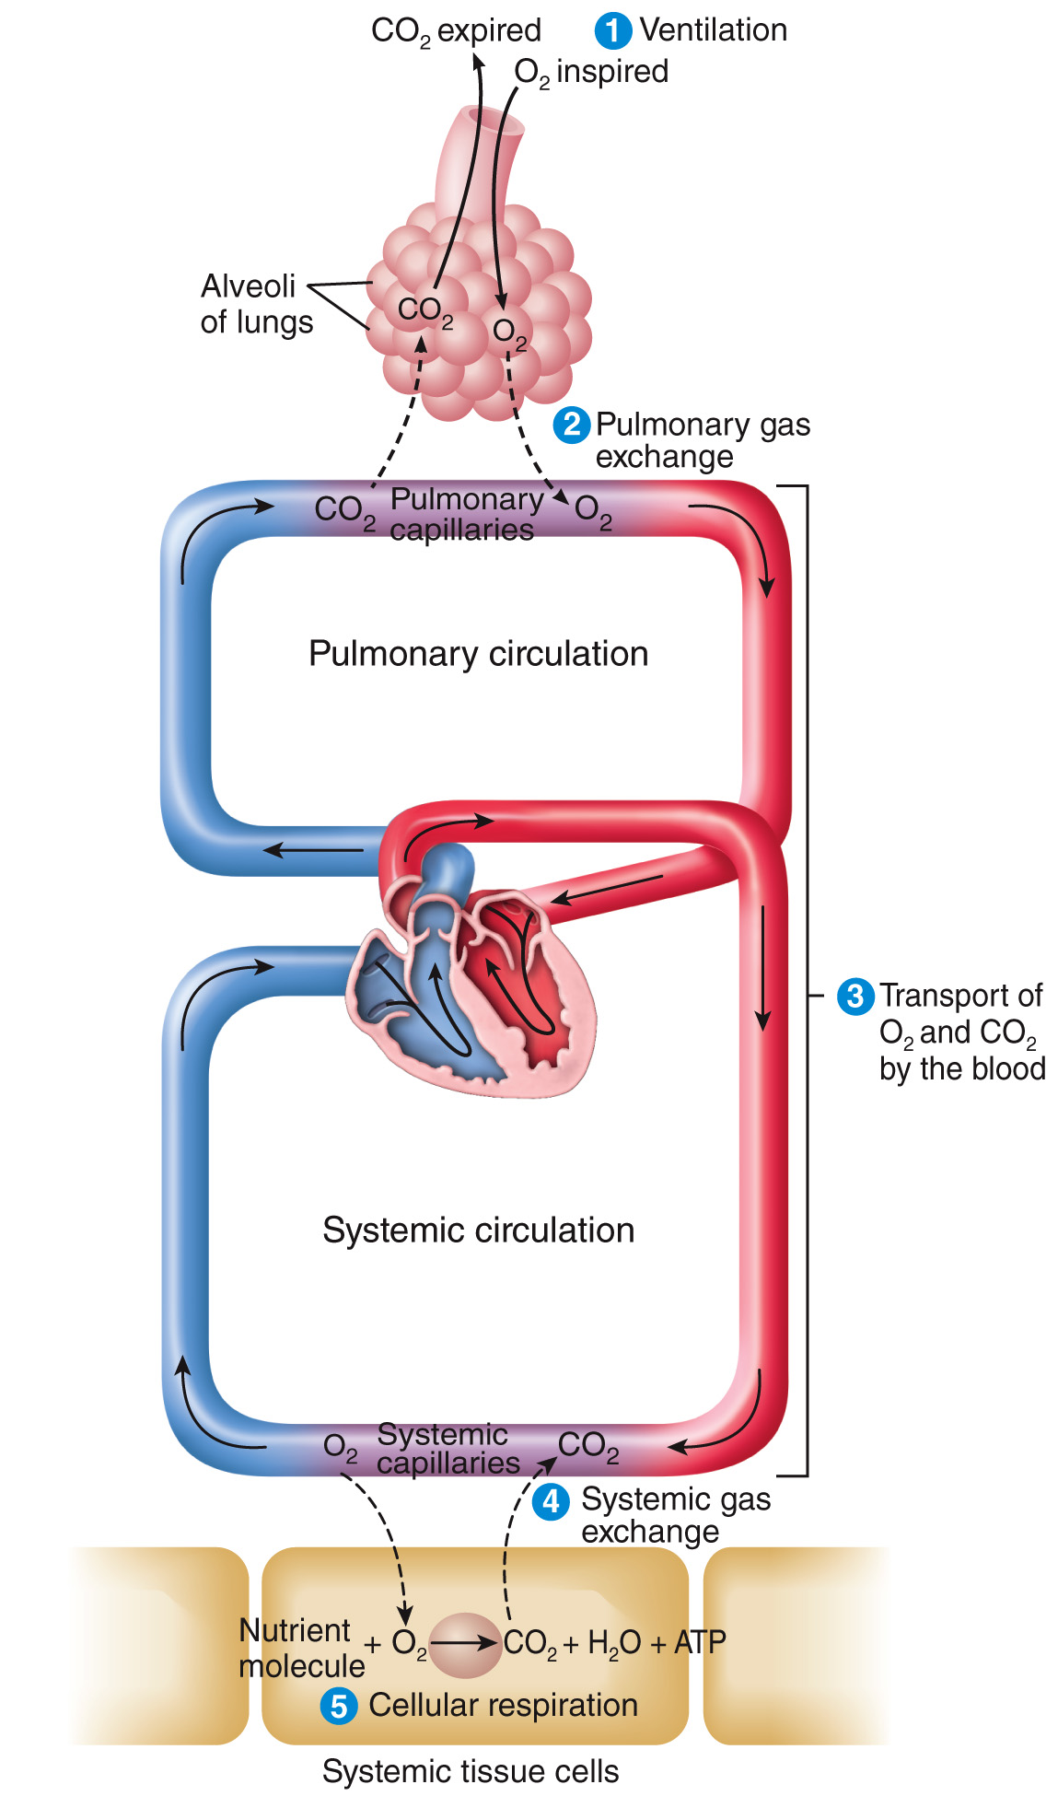
In humans: Respiration
External: lungs expansion/contraction
Ventilation
oxygen (O₂)/carbon dioxide (CO₂) exchange
Internal: microscopic gas exchange
Cellular respiration

Slide 4
Ubiquity of Cellular respiration
Exchange of atmospheric oxygen O₂ for carbon dioxide CO₂
(almost) ALL ORGANISMS USE IT FOR PRODUCING METABOLIC ENERGY
Humans
Plants
Animals
Fungi
Unicellular organisms
Even most procaryotes (bacteria) use similar processes

Slide 5
How long can a cell survive without oxygen?
Tissue | Survival time
Brain | <3 min
Kidney and liver | 15-20 min
Skeletal muscle | 60-90 min
Vascular smooth muscle | 24-72 h
Hair and nails | Several days
Tolerance to hypoxia of various tissues

Slide 6
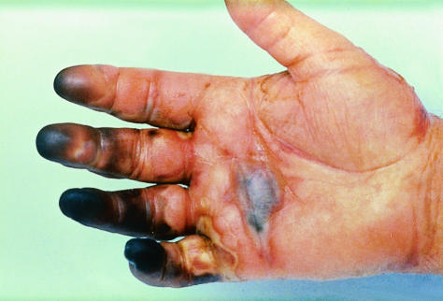
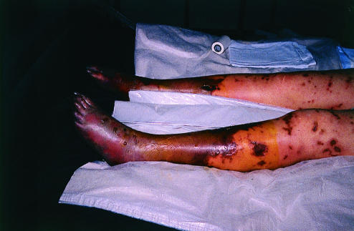
Effects of tissue hypoxia (low oxygen)
Ischaemia is a symptom of tissue hypoxia
Severe tissue hypoxia due to capillary microthrombosis in critically ill patient with meningococcal septicaemia
Lack of oxygen may lead to tissular death and organ amputation

Slide 7
Final result of cell respiration: synthesis of ATP from ADP
ADP + PO₄⁻² + O₂ + energy = ATP + H₂O + CO₂

Slide 8
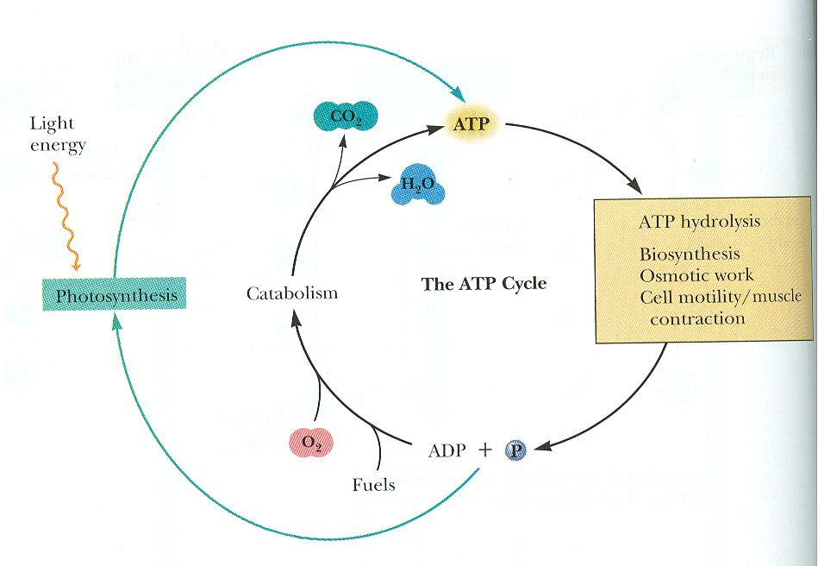
Where does the energy come from? Where does it go?
Source of energy
Proxy: food
Actual initial source: sunlight (photosynthesis)
- High energy electrons in food (fuels) supply the energy for ATP synthesis
Final destination of energy: metabolism
Basal metabolism
Biosynthesis
Motility
Many other biological processes
Example: carbohydrate synthesis
Light + 6 CO₂ + 6 H₂O → C₆H₁₂O₆

Slide 9
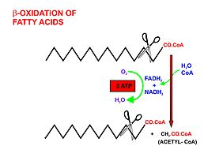
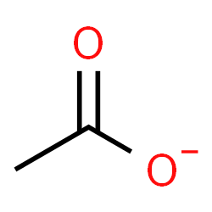
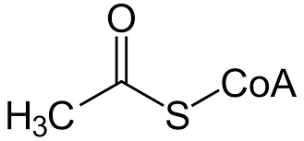
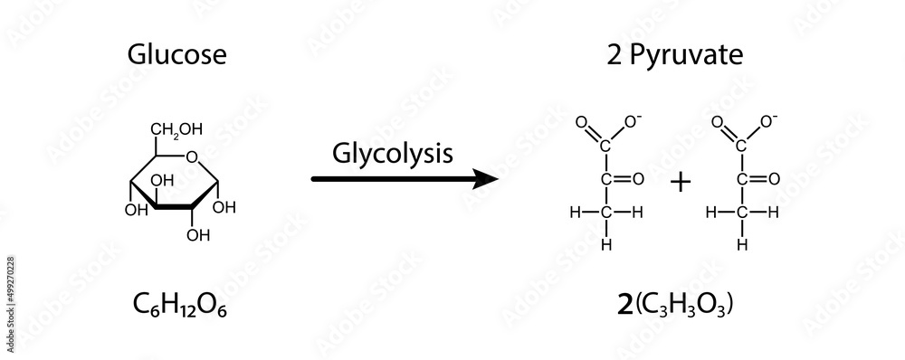
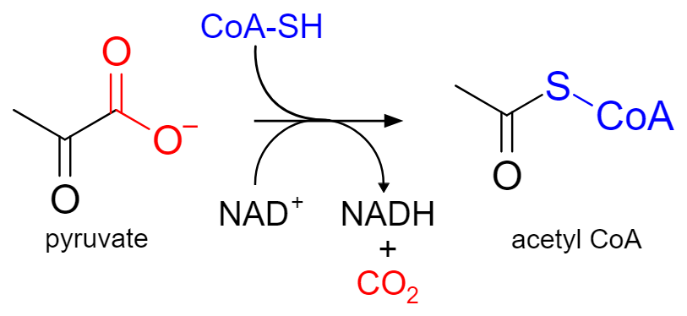
Acetate (as AcetylCoA) is the main source of energy
Acetyl-CoA (vitamin B₅, acetate donor) is the main source of energy
ACETATE
Source of energy: fatty acids
Process: β-oxidation
(mitochondrion)
Source of energy: carbohydrates
Process: Glycolysis
(cytoplasm)

Slide 10
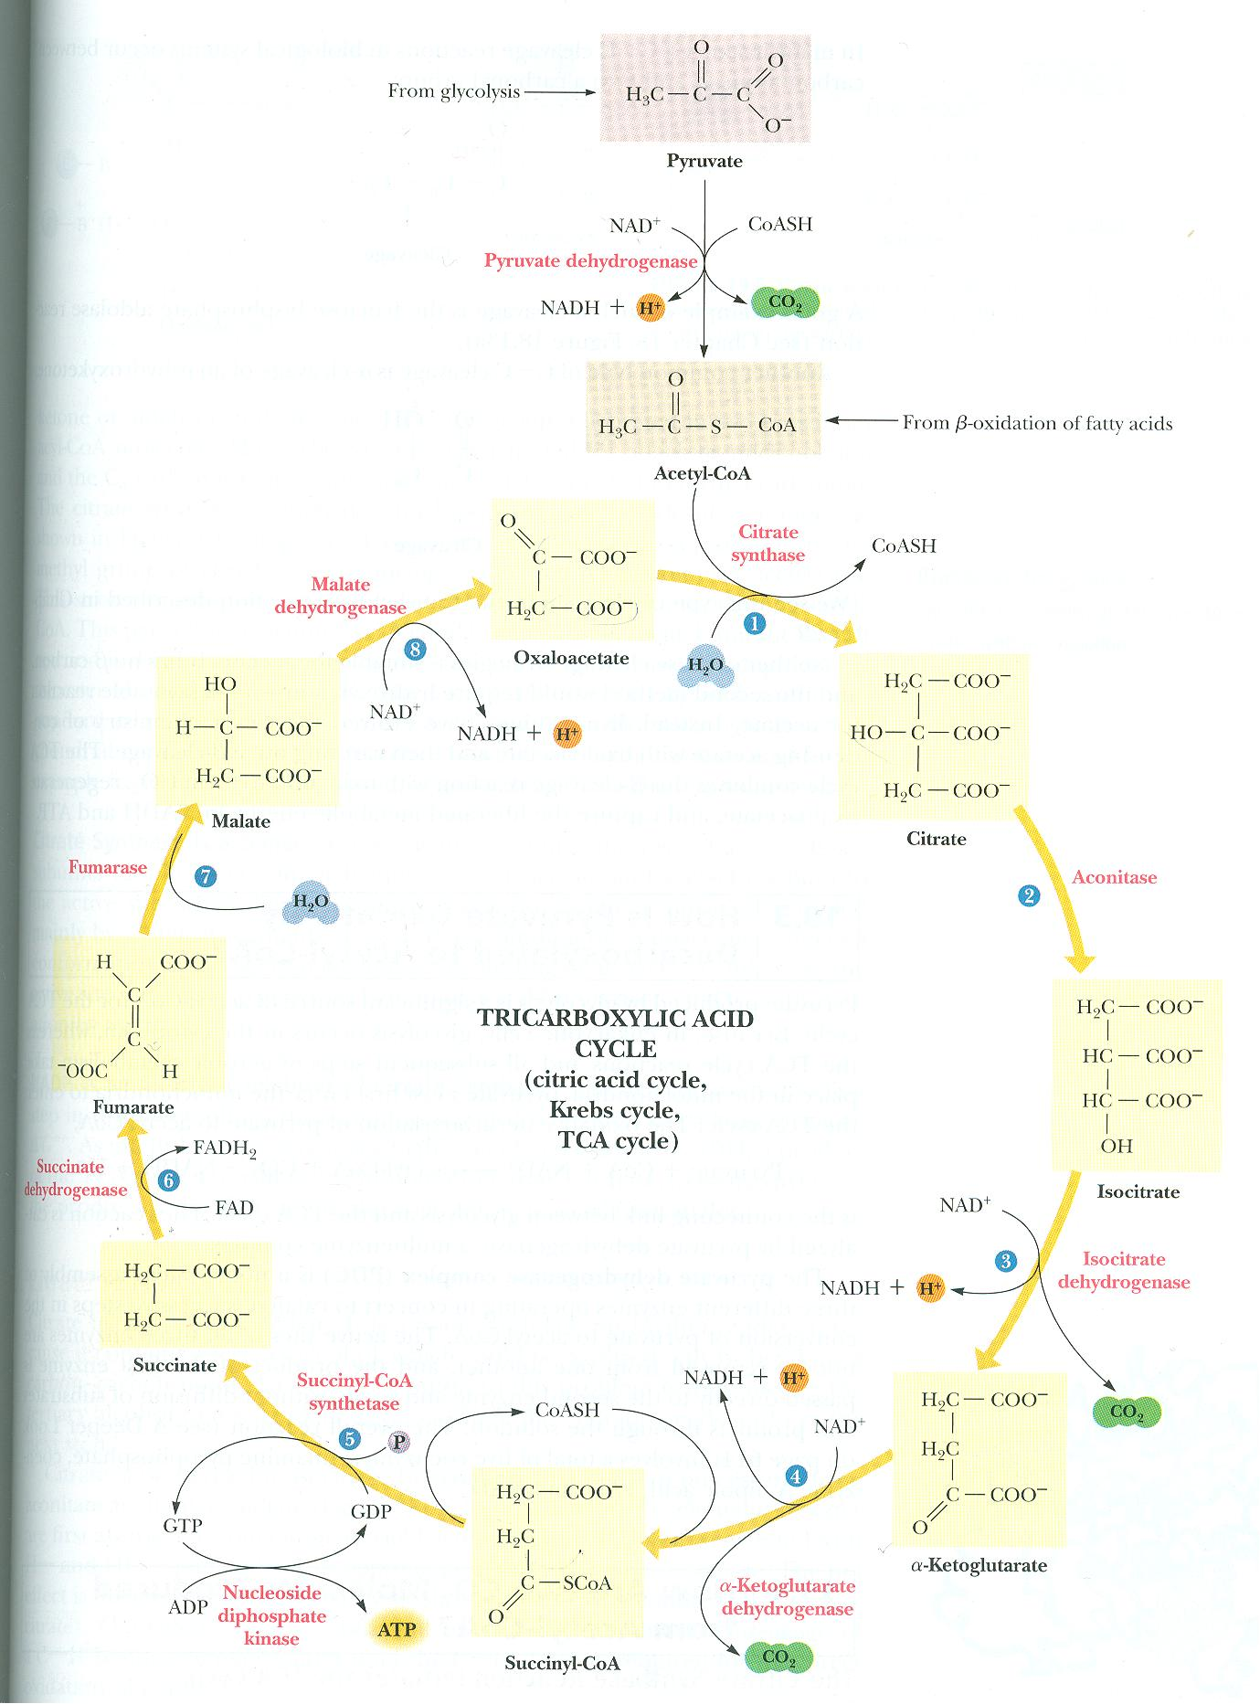
Krebs cycle (mitochondrial matrix)
Production of NADH
And
FADH₂ from Acetate
(AcetylCoA)
Krebs cycle
Acetate feeds the Krebs cycle (complex biochemical process)
allowing protonation (H⁺ binding) of two intermediate products:
NADH: Nicotinamide (vitamin B₃), and
FADH₂: Flavoprotein (vitamin B₂, or riboflavin)
NADH and FADH₂ are
proton donors in mitochondria
NAD⁻ + H⁺ → NADH
and
FAD⁻ + 2H⁺ → FADH₂

Slide 11
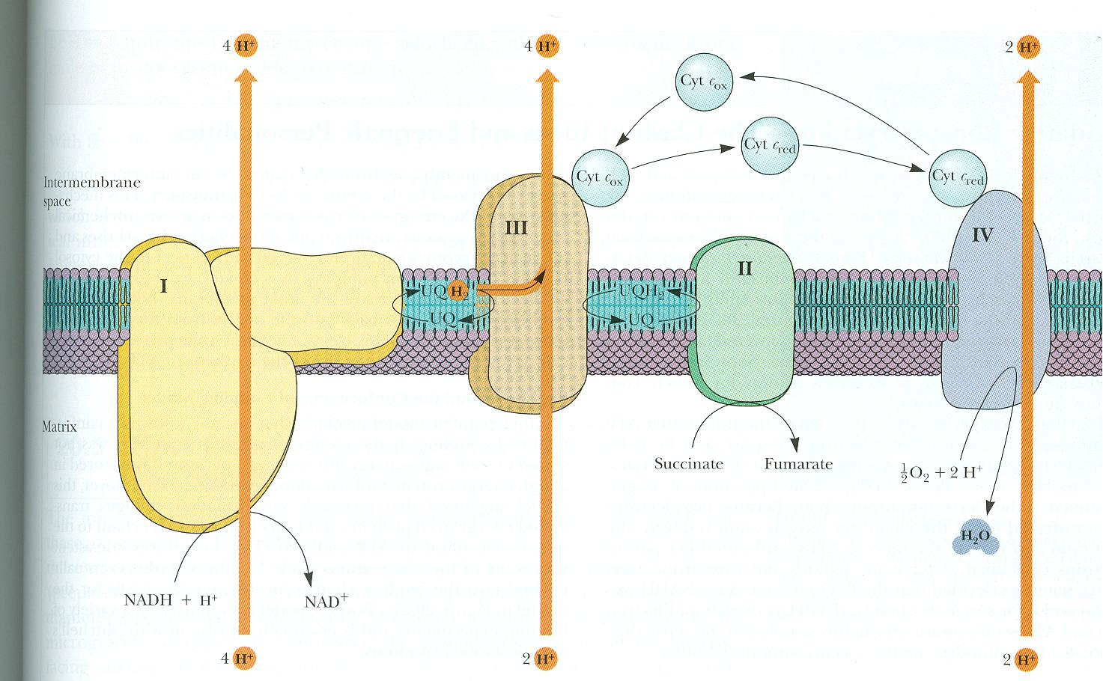
Oxidative Phosphorylation (mitochondria)
Creation of the proton gradient by a chain of cytochrome oxidoreductions
In the presence of O₂, a series of protein complexes use cytochrome, iron, and copper (complexes I-II-III-IV) to:
take protons from NADH and FADH₂
move them from the Matrix to the Intramembrane Mitochondrial (IM) membrane, and hence
create a H⁺ gradient
across the mitochondrial membrane
high [H⁺]_{IM space}
(IM space)
low [H⁺]_{Matrix}
This process needs oxygen (O₂)
H⁺ gradient = [H⁺]_{IM space} - [H⁺]_{Matrix}

Slide 12
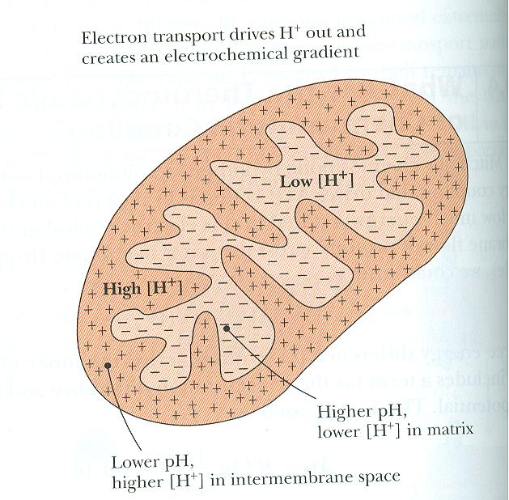
Where is mitochondrial energy stored?
Proton gradients temporarily store energy in mitochondria
matrix
Intermembrane space

Slide 13
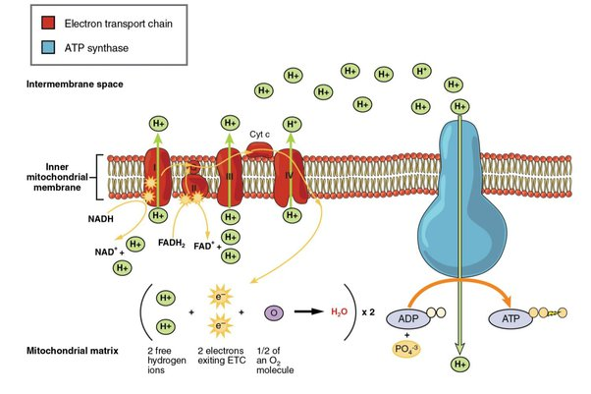
A reverse proton pump synthetizes ATP
“Normally”, a membrane pump (ATP-ase) uses energy from ATP to transport ions (in this case protons) against their gradient.
Conversely in conditions of low-ATP/high-ADP concentrations and strong H⁺ gradient, the H⁺ pump works in reverse turning ADP into ATP
In the matrix of mitochondria:
In the presence of a H⁺ gradient, ATP is synthesized from ADP
How:
Using an ATP-ase hydrogen (H⁺) pump working in reverse mode

Slide 14
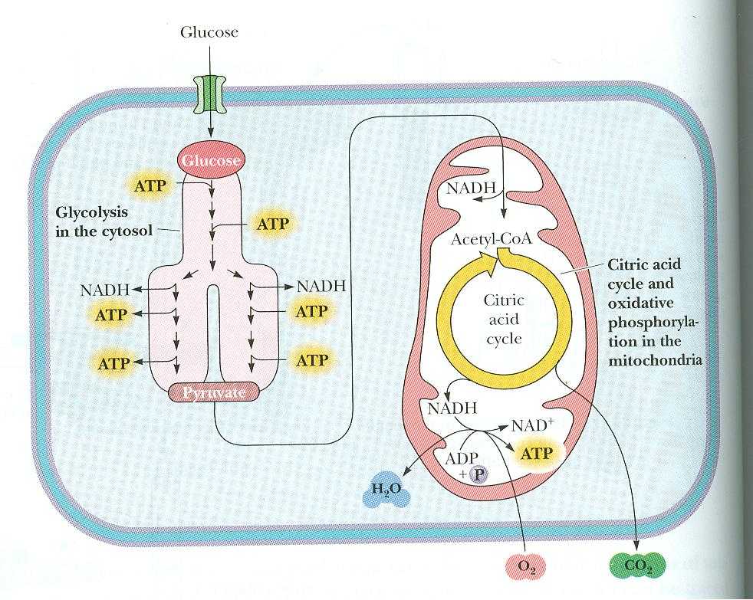
Aerobic vs anaerobic energy production
Small amounts of energy can be produced anaerobically for instance, from Krebs cycle (1 ATPs, O₂ not needed)
On the contrary
The production of larger amount of energy (≈ 5 ATPs per Krebs cycle), using any nutrients, including fatty acids,
requires oxidative phosphorylation
(and O₂)
CO₂ is a waste product of cellular respiration
Cellular respiration

Slide 15
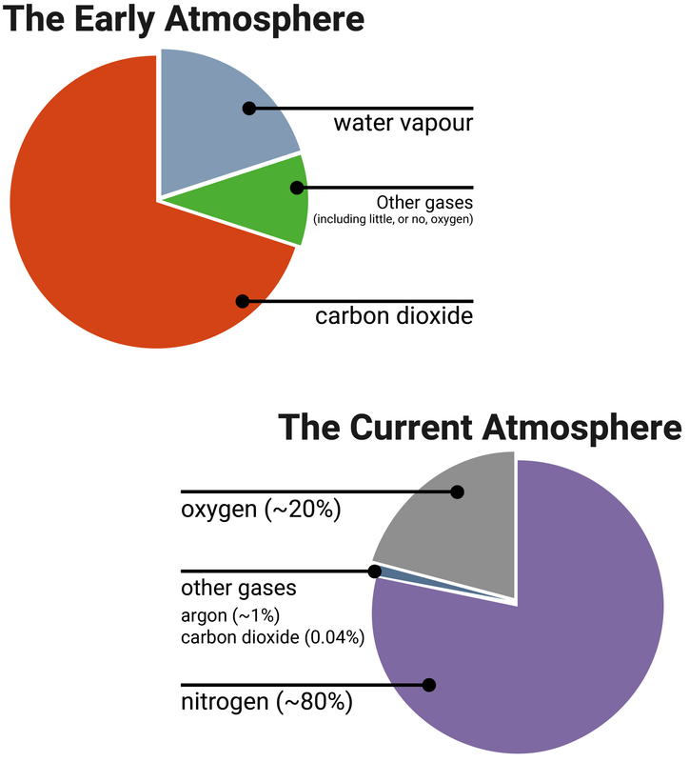
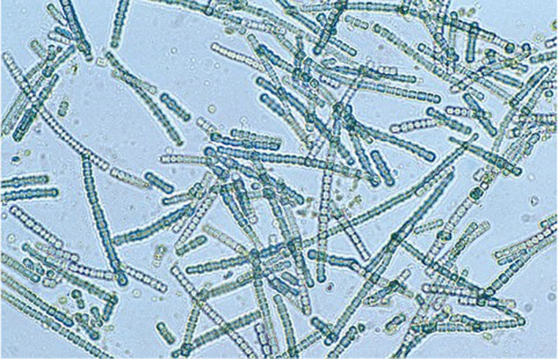
Where does atmospheric O₂ come from?
6 CO2 + 6 H2O + energy = C6H12O6 + 6 O2
2B years ago: from CYANOBACTERIA
cyanobacteria use(d) CO₂, and split H₂O into hydrogen and oxygen:
Cyanobacteria have blue‐green color.
They first appeared about 2 billion years ago in the evolution of the Earth’s atmosphere. Responsible for the Great Oxidation
Since then, land plants and sea algae release:
O₂ during day (with light), and
CO₂ during the night (in darkness)
Overall, plants produce 10 times more O₂ than CO₂

Slide 16
summary
Nutrients are taken in by cells
They are broken down into pyruvate/acetate/acetyl-CoA
Krebs cycle uses acetate to protonate NAD⁻ and FAD⁻²
NADH and FADH₂ create a proton gradient in mitochondria by oxidative phosphorylation (using oxygen)
The proton gradient induces the synthesis of ATP from ADP
(in most animals the protein hemoglobin carries the poorly water-dissolvable O₂ inside the blood)

Slide 17
appendix

Slide 18
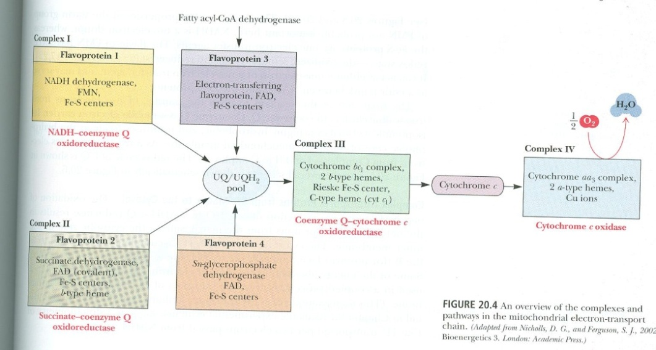
Role of the Ubiquinone complexes
oxygen from respiration
It is in this biochemical step that
we have a knowledge gap

Slide 19
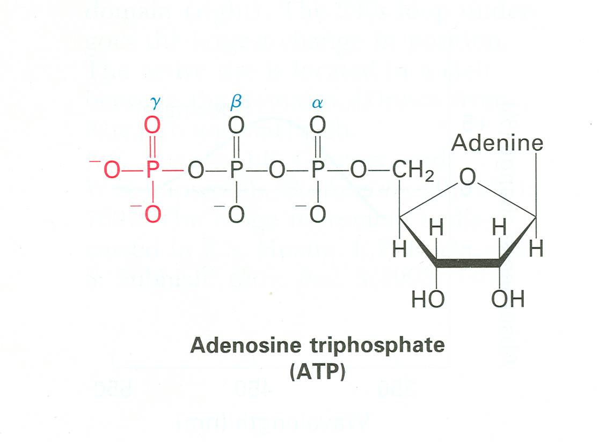
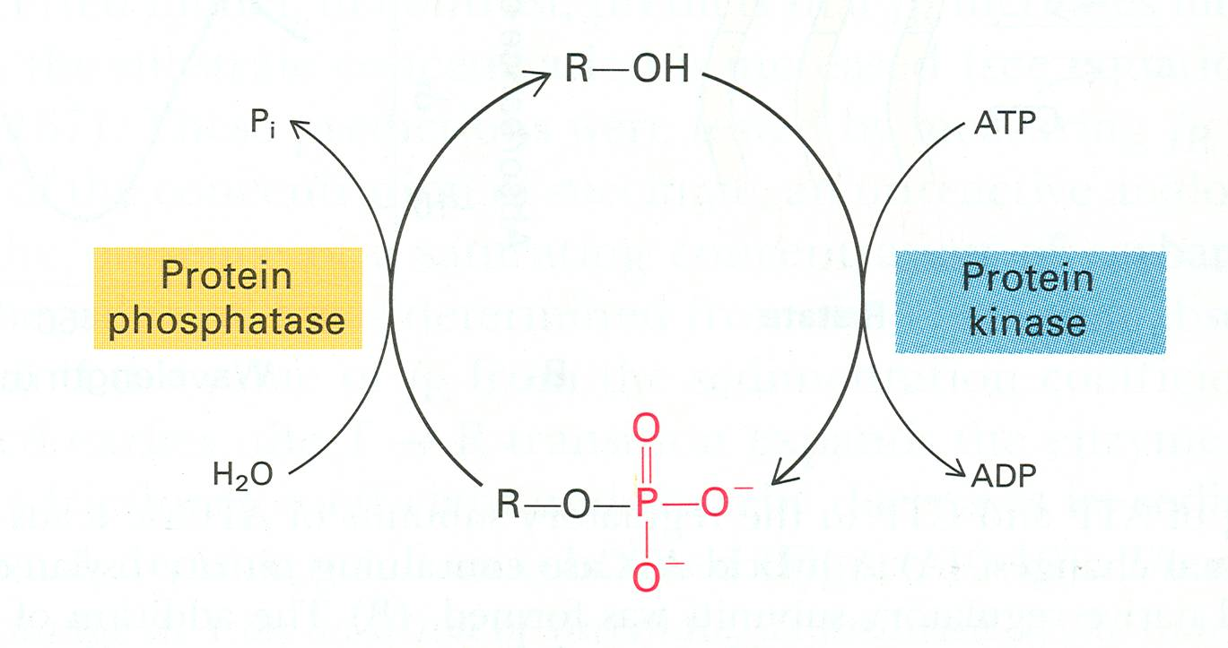
Purpose of ATP: catalyze Phosphorylation
phosphorylation: reversible process
- protein kinases and
- protein phosphatases
Kinases:
Enzymes (proteins) that induce phosphorylation
(attachment of a PO4– group)
Phosphatases:
Enzymes that induce de-phosphorylation
(removal of a PO4– group)

Slide 20
Behavior needs to be reversible
Example: Protein phosphorylation
Covalent and reversible binding of a phosphate group (PO₄²⁻ )
Phosphorylation (typically) leads to temporary increase of function in the phosphorylated protein with corresponding behavioral change

Slide 21
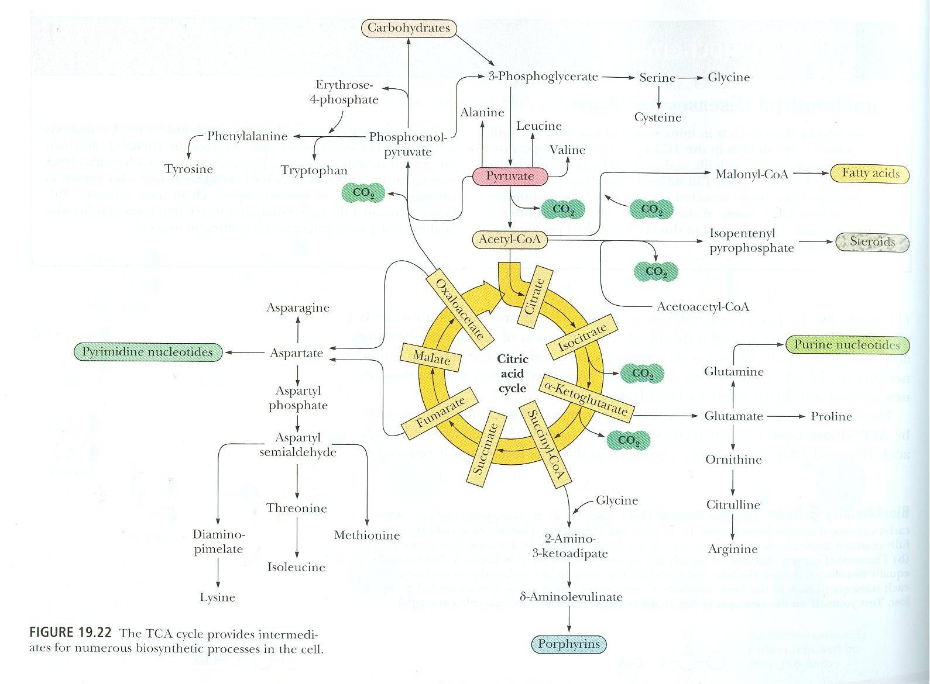
Krebs cycle in the synthesis of biomolecules
Most biological important molecules (most aminoacids, nucleotide bases, steroids, neurotransmitters, fatty acids, etc.) can be synthetized from Krebs’ cycle

Slide 22
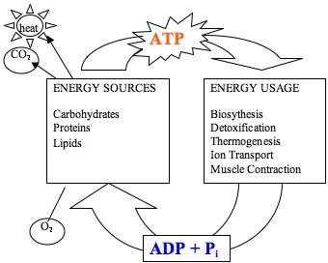
Role of oxygen (O₂)
Carbohydrates
Proteins
Lipids
Biosynthesis
Ion transport
Muscle contraction
Growth
Inflammation
Eventually:
O₂ is necessary to convert ADP + phosphate (PO₄⁻²) into ATP

Slide 23
Mitochondria at the Origin of life
Hypothesis for origin of life:
protobacteria (already using cellular respiration) were incorporated into protocells, and turned into mitochondria, allowing eukaryotic life

