Slide 1
TRP Channels in the Brain: What Are They There For?.
Authors
Sawamura S, Shirakawa H, Nakagawa T, Mori Y, Kaneko S.
Editors
In: Emir TLR, editor.
Source
Neurobiology of TRP Channels. 2nd edition. Boca Raton (FL): CRC Press/Taylor & Francis; 2017. Chapter 16. Frontiers in Neuroscience.

Slide 2
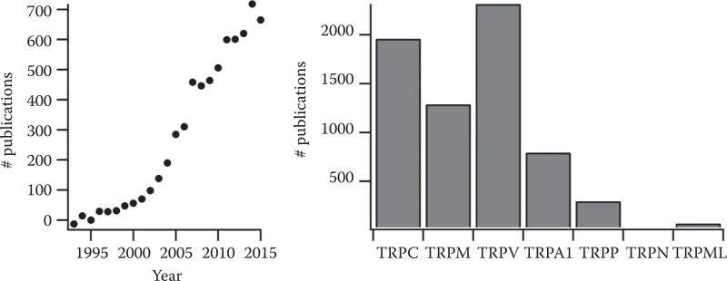
TRP OR [Transient Receptor Potential] AND channel
TRP channels are members of the voltage-gated superfamily of ion channels that includes the voltage gated K⁺, Na⁺, and Ca²⁺ channels as well as related cyclic nucleotide-gated channels. They form as tetramers of identical subunits (Figure 1.2), although heterotetramers of TRP channel subunits have been reported (reviewed in Cheng et al., 2010). Like other members of the voltage-gated superfamily, each subunit includes six membrane-spanning helices with a reentrant pore loop between the fifth and six transmembrane helices, and intracellular amino- and carboxy-terminali. The first four transmembrane segments (Figure 1.2, blue) form the voltage-sensing or voltage-sensing-like domain. The remaining two transmembrane segments, along with the reentrant pore loop (Figure 1.2, yellow), form the ion-conducting pore of the channel.

Slide 3
TRP channels are SENSORS for a great variety of stimuli
Although some TRP channels (e.g., TRPM8) show voltage-dependent activation (Voets et al., 2007); others show little or no voltage-dependent gating (e.g., TRPV1) (Liu et al., 2009).
the macroscopic current-voltage relationship of TRPV1 shows significant outward rectification. However, this is due almost exclusively to rectification in the unitary conductance

Slide 4
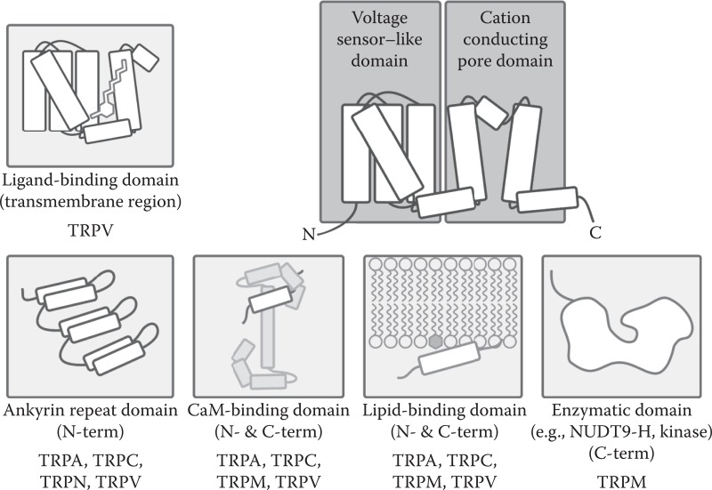

Slide 5
1.2. TRPA
The TRPA subfamily contains only one member, TRPA1, so named for its extensive N-terminal ankyrin repeat domain (ARD) (Figure 1.2). Whereas many TRP channels contain an ARD, with at least 14 ankyrin repeats TRPA1 has the most of any identified mammalian TRP. The gene encoding TRPA1 is conserved from flies to mammals, and in humans the protein is expressed in sensory nerves, as well as other tissues. TRPA1's activity can be regulated by temperature, as with members of the TRPV and TRPM family; however, TRPA1's temperature sensitivity is strongly species dependent, with different species demonstrating wildly different temperature activation profiles for TRPA1
The ankyrin repeat is a 33-residue motif in proteins consisting of two alpha helices separated by loops, first discovered in signaling proteins in yeast Cdc10 and Drosophila Notch
its namesake ankyrin contains 24
The ankyrin fold appears to be defined by its structure rather than its function, since there is no specific sequence or structure that is universally recognised by it.
Sub-Family | Cell/Tissue Expression | Group
TRPA1 | DRG, TG, hair cells, fibroblasts, ovary, spleen, testis | 1

Slide 6
1.3. TRPC
The TRPC (for “classical” or “canonical”) subfamily contains the TRP channels most closely related to the first identified TRP channel (Cosens and Manning, 1969; Minke et al., 1975). Since the discovery and cloning of the original trp locus in Drosophila, seven TRPC genes have been reported. Humans contain genes encoding TRPC1, TRPC3, TRPC4, TRPC5, TRPC6, and TRPC7, but lack the TRPC2 gene found in mice and other species.
Sub-Family | Cell/Tissue Expression | Group
TRPC1 | Ubiquitous; heart, brain, testis, ovary, liver, spleen | 1
TRPC2 | Vomeronasal organ (VNO), testis
TRPC3 | Central Nervous System (CNS), cardiac and smooth muscle
TRPC4 | CNS, placenta, adrenal gland, endothelium, retina, smooth muscle, testis, kidney, interstitial cells of Cajal
TRPC5 | CNS (especially developing fetal brain)
TRPC6 | Lung, brain, placenta, ovary, kidney (podocytes), spleen, small intestine, neutrophils, smooth muscle
TRPC7 | Heart, lung, eye, pituitary gland

Slide 7
1.4. TRPM
In many ways, the TRPM subfamily is the most enigmatic and diverse of the TRPs. Its founding member, TRPM1, derives its name (“TRP melastatin 1”) from its putative role as a melanoma suppressor (Duncan et al., 1998). Whereas currents sensitive to TRPM1 siRNA have been recorded from melanocytes, attempts to record activity directly from recombinant TRPM1 have been so far unsuccessful (Oancea et al., 2009). This subfamily also contains the unique class of “chanzymes,” in which an enzymatic domain has been evolutionarily fused to the TRP channel (Figure 1.5). Such chanzymes include TRPM2, which contains a NUDT9 homology domain that hydrolyzes adenosine diphosphate ribose (Kuhn and Luckhoff, 2004), and TRPM6 and TRPM7, and each contain a functional protein kinase (Runnels et al., 2001).
TRPM8 is perhaps the best-studied member of the TRPMs, and is activated by noxious cold, and chemical compounds such as menthol and eucalyptus (McKemy et al., 2002). Recent work has also demonstrated that TRPM8 can serve as a physiologically relevant receptor for testosterone

Slide 8
Sub-Family | Cell/Tissue Expression | Group
TRPM1 | Melanocytes, retina, brain | 1
TRPM2 | Brain, bone marrow, neutrophils, lung, spleen, eye, heart, liver
TRPM3 | Kidney, CNS, pituitary, testis, ovary, pancreas, sensory neurons
TRPM4 | Heart, pancreas, prostate, testis, colon, macula densa (kidney), lung, placenta, smooth muscle
TRPM5 | Tongue, GI-tract, liver, lung, testis, brain, pancreas
TRPM6 | Kidney, GI-tract
TRPM7 | Kidney, bone, heart, pituitary, adipose
TRPM8 | DRG, TG, liver, smooth muscle, stomach, bladder, prostate

Slide 9
1.5. TRPML
The three mucolipins, TRPML1–3 (also known as MCOLN1–3) are named after loss of function mutations in TRPML1 that result in the neurodegenerative disease type IV mucolipidosis (reviewed in Slaugenhaupt, 2002). TRPMLs are the most distantly connected subfamily and lack the extensive cytoplasmic N- and C-termini found in many other TRPs. This may be related to their subcellular localization; whereas many TRPs are known to traffic to the plasma membrane where they exert their physiological functions, TRPMLs predominantly localize to intracellular membranes of the endo- and exocytosis pathways (reviewed in Venkatachalam et al., 2015). Although the endogenous regulation of TRPMLs is not well understood, it is known that the activity of these channels is regulated by phosphoinositides (Dong et al., 2010), as is true for most other TRP channels (Zheng and Trudeau, 2015). Recently, synthetic agonists for the TRPMLs have been developed to facilitate further study of these channels (Shen et al., 2012; Grimm et al., 2010).
Sub-Family | Cell/Tissue Expression | Group
TRPML1 | Brain, heart, skeletal muscle, | 2
TRPML2 | Intracellular ion channel
TRPML3 | Cochlea

Slide 10
1.6. TRPN
Absent from mammals, the TRPN (“No mechanoreceptor potential C,” also called NOMPC) protein forms a mechanosensitive channel (Walker et al., 2000). Mechanosensitivity is imparted by the N-terminal ARD, which dwarfs even TRPA1's, with its 29 ankyrin repeats. These ankyrin repeats have been shown to interact with cellular microtubules, and this association is required to impart mechanosensitivity to the channels
Sub-Family | Cell/Tissue Expression | Group
TRPN1 | Ear, eye | 1

Slide 11
1.7. TRPP
The TRPPs, or polycystins, are similar to the TRPMLs in that they were identified from disease-causing mutations, and bear little similarity to the rest of the TRP superfamily (Mochizuki et al., 1996). Although TRPPs are among the most widely expressed TRPs (Figure 1.6), the effects of human mutations in TRPP1 are relatively limited to the kidney, where such mutations cause autosomal dominant polycystic kidney disease (ADPKD) (reviewed in Ong and Harris, 2015). TRPP1 interacts with PKD1, an 11 transmembrane domain protein also mutated in ADPKD (Hanaoka et al., 2000).
Two other TRPPs—TRPP2 and TRPP3 (also called PKD2L2 and TRPP5)—have been identified, and TRPP2 has been suggested to be the receptor for sour tastes (Huang et al., 2006; Ishimaru et al., 2006; LopezJimenez et al., 2006). TRPPs are often found localized to primary cilia, where it has been proposed that they have a role in regulating flow-induced calcium transients (Nauli et al., 2003), although recent pressure-clamp studies of primary cilia indicate that TRPPs in primary cilia are only mechanosensitive at high pressures (DeCaen et al., 2013).
Sub-Family | Cell/Tissue Expression | Group
TRPP2 | Ubiquitous; kidney, ovary, testis, small intestine | 2
TRPP3 | Heart, skeletal muscle, kidney, spleen, retina, liver, testis, brain
TRPP5 | Testis, heart, kidney, brain

Slide 12
1.8. TRPV
TRPVs are named for the role of the founding member, TRPV1, as the receptor for the pungent vanilloid capsaicin (Caterina et al., 1997). Despite this nomenclature, only TRPV1 has so far been shown to be gated by vanilloids. TRPVs are by far the best-studied TRP subfamily (Figure 1.1), in large part due to the pharmacological accessibility and clear knockout phenotype of TRPV1 (Caterina et al., 1997). TRPV1 is highly expressed in sensory nerves (Figure 1.6), where it acts as a multimodal integrator of noxious stimuli, gating in response to noxious compounds, heat, lipids, and protons (Caterina et al., 1997, 2000; Lukacs et al., 2007, 2013; Rohacs et al., 2008; Klein et al., 2008; Senning et al., 2014; Ufret-Vincenty et al., 2015).
TRPV1 was the first TRP for which a near-atomic structural model was determined (Liao, 2013), confirming that TRPs form tetramers of subunits with six transmembrane domains each (Figure 1.2). The TRPV family also includes the mechanosensitive channels TRPV4 and TRPY1 (the yeast homologue to TRPV channels) (Palmer et al., 2001; Strotmann et al., 2000; Liedtke et al., 2000). Alternative splice variants of TRPV1 are also thought to be mechanosensitive, responding to changes in osmotic pressure (Sharif Naeini et al., 2006; Zaelzer et al., 2015). Most TRPV channels display calcium-dependent modulation in addition to being permeable to calcium (reviewed in Gordon-Shaag et al., 2008), and TRPV5 and TRPV6 have been shown to be directly modulated by CaM (Lambers et al., 2004).

Slide 13
Sub-Family | Cell/Tissue Expression | Group
TRPV1 | Dorsal root ganglia (DRG), trigeminal ganglia (TG), brain, peripheral nerve ends, skin, bladder, pancreas, testis | 1
TRPV2 | DRG, CNS, GI-tract, spleen, mast cells, smooth, cardiac, and skeletal muscle cells
TRPV3 | DRG, TG, CNS, skin, tongue, testis, hair follicles
TRPV4 | CNS, DRG, TG, kidney, lung, spleen, heart, liver, skin, endothelium, testis, bladder, cochlea, osteoblasts
TRPV5 | Kidney, GI-tract, pancreas, placenta, testis, prostate, brain, salivary glands
TRPV6 | GI-tract, kidney, pancreas, placenta, testis, prostate, brain, salivary glands

Slide 14
Chapter 16TRP Channels in the Brain
What Are They There For?
Seishiro Sawamura, Hisashi Shirakawa, Takayuki Nakagawa, Yasuo Mori, and Shuji Kaneko.

Slide 15
Upon activation, TRP channels depolarize the membrane potential, which can lead to activation or inactivation of voltage-gated ion channels, and regulate Ca²⁺ signaling, which controls diverse cellular functions (Wu et al., 2010; Nilius and Szallasi, 2014). It is well known that some members of the TRP canonical (TRPC), TRP melastatin (TRPM), and TRP vanilloid (TRPV) subfamilies of TRP channels are highly expressed and play important roles in the brain (Vennekens et al., 2012; Nilius and Szallasi, 2014). They regulate diverse neuronal and glial functions including developmental and homeostatic functions of the brain. Recent studies show that dysregulation of the TRP channel functions is involved in various pathological events of neurological and psychiatric disorders.

Slide 16
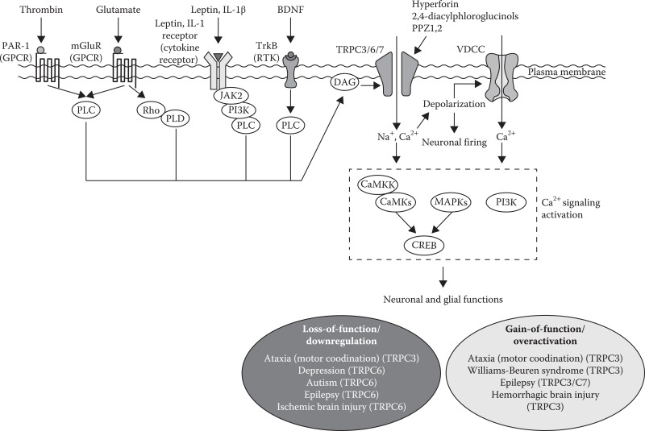
TRPC receptor-operated cation channels and have been implicated in various cellular functions including neuronal firing, synapse transmission, gene expression, migration, neurite elongation, and growth cone guidance

Slide 17
TRPC3, TRPC6, and TRPC7 form the diacylglycerol (DAG)-sensitive group, which is activated by direct action of DAG upon phospholipase C (PLC)-coupled receptor stimulation such as G_{q/11} type G protein-coupled receptors (GPCRs) or receptor tyrosine kinases (RTKs)
TRPC3, TRPC6, and TRPC7 are highly expressed in various regions of the brain (Tables 16.1 through 16.3) and play important roles in many neuronal functions in response to neuronal receptor stimulation; they are also involved in various neuronal diseases and psychiatric disorders
TRPC5 is regulated by Ca²⁺ and oxidative stress (Yoshida et al., 2006; Blair et al., 2009). These channels are also involved in certain physiological and pathological events in the brain. TRPC2 is primarily expressed in the vomeronasal organ

Slide 18
Table 16.1Expression of TRPC3 in Brain Tissues or Cells and Methods of Detection
Expressed Tissues or Cells | Detection Methods | References (species)
Cerebrum cortex | RT-PCR, qRT-PCR, WB, IHC | Mouse (Kunert-Keil et al., 2006), rat (Li et al., 1999; Mizuno et al., 1999; Roedding et al., 2013)
Hippocampus | RT-PCR, qRT-PCR, ISH, WB, IHC, ICC | Mouse (Kunert-Keil et al., 2006; Li et al., 2012a; Zeng et al., 2015a), rat (Li et al., 1999; Singh et al., 2004; Chung et al., 2006)
Cerebellum | RT-PCR, WB, IHC | Human (Roedding et al., 2009), mouse (Kunert-Keil et al., 2006), rat (Li et al., 1999; Huang et al., 2007)
Purkinje cell | ISH, WB, IHC | Mouse (Becker et al., 2009; Kato et al., 2012; Mitsumura et al., 2011; Kim et al., 2012), rat (Huang et al., 2007)
Granule neuron | RT-PCR, WB | Rat (Li et al., 2005; Jia et al., 2007; Sawamura et al., 2016)
Striatum | RT-PCR, single cell RT-PCR, ISH, WB, IHC | Mouse (Kim et al., 2012), rat (Kim et al., 2012; Xie and Zhou, 2014), guinea pig (Kim et al., 2012)
Substantia nigra | RT-PCR, single-cell RT-PCR, IHC, EM | Mouse (Zhou et al., 2008a), rat (Sylvester et al., 2001; Fusco et al., 2004)
Amygdala | WB, IHC | Rat (Li et al., 1999)
Pontine neuron | WB, IHC | Rat (Li et al., 1999)
Astrocyte | qRT-PCR, WB, IHC, EM | Rat (Fusco et al., 2004; Shirakawa et al., 2010)
Microglia | IHC, ICC, EM | Rat (Fusco et al., 2004; Mizoguchi et al., 2014)
Oligodendrocyte | IHC, EM | Rat (Fusco et al., 2004)
Basilar artery | qRT-PCR, IHC | Rat (Song et al., 2013)
Pituitary cell | qRT-PCR | Rat (Tomic et al., 2011)

Slide 19
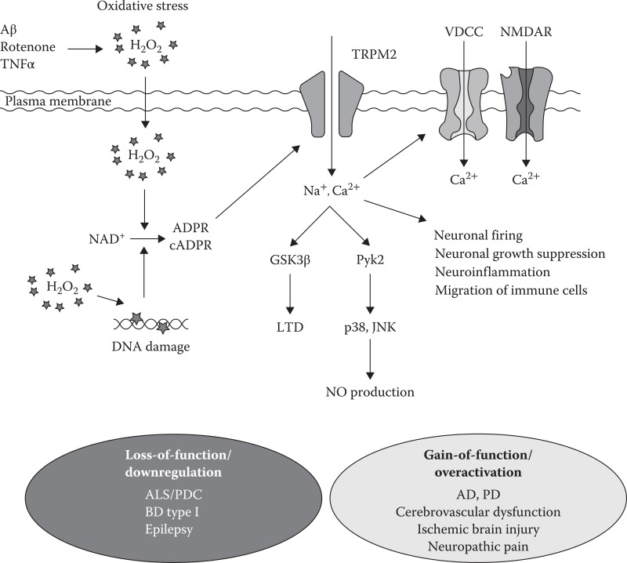
The TRPM subfamily contains eight members: TRPM1–TRPM8. The activity of some TRPM proteins is modulated by oxidative stress (Simon et al., 2013). Specifically, TRPM2 is highly expressed in the brain (Table 16.4), and its role in the central nervous system (CNS) has been studied. It is the first identified redox-sensitive TRP channel (Hara et al., 2002) and forms a Ca²⁺-permeable cation channel, which is activated by oxidative stress mediated by reactive oxygen species (ROS), such as hydrogen peroxide (H₂O₂) through the production of nicotinamide adenine dinucleotide (NAD⁺), and its metabolites such as ADP-ribose (ADPR) and cyclic ADPR (Takahashi et al., 2011), although some controversy exists on whether NAD⁺ and cADPR are direct activators of TRPM2 (Toth et al., 2015; Rosenbaum, 2015). Studies indicate that TRPM2 mediates H₂O₂-induced Ca²⁺ influx, which modulates physiological and pathological cellular functions. TRPM2 is expressed in both neurons and glia, and oxidative stress-induced TRPM2 activation is implicated in neuronal diseases (Figure 16.2).

Slide 20
16.1.4. TRPV Channels in the Brain
The TRPV subfamily contains six members: TRPV1–TRPV6. All TRPV channels form Ca²⁺-permeable cation channels. The function of TRPV1 has been investigated using highly selective exogenous agonists such as capsaicin and resiniferatoxin (RTX). Physiologically, TRPV1 is thought to be activated by physical or chemical stimuli such as noxious heat (>43°C), mechanical force, pH change, ROS, and endogenous compounds such as arachidonic acid metabolites and endocannabinoids (Rosenbaum and Simon, 2007; Takahashi and Mori, 2011; Nilius and Szallasi; 2014). TRPV1 was initially thought to be expressed mainly in sensory neurons; however, research has shown broad expression in the brain (Table 16.5) and physiological roles of TRPV1 in central neurons and glia. It has also been suggested that TRPV1 plays a role in neuronal and psychiatric disorders. TRPV4 is also activated by wide variety of physical and chemical stimuli including hypotonicity, heat (>25°C), and endocannabinoids (Everaerts et al., 2010; Wu et al., 2010). TRPV4 expression has been detected in several regions of the brain, and its contribution to neuronal and glial functions has been investigated.

Slide 21
TRPC1 is involved in brain-derived neurotrophic factor (BDNF)- and netrin-1-induced axon guidance (Li et al., 2005; Shim et al., 2009). TRPC1 is activated by peptidic hormone leptins through a Janus kinase-2 (JAK2)/phosphoinositide 3-kinase (PI3K)/PLCγ pathway, and its activation mediates the depolarizing effects of leptins in hypothalamic proopiomelanocortin neurons (Qiu et al., 2010). In hippocampal neurons, TRPC1 and TRPC3 are required for leptin-induced current and spine formation
TRPC5 is suggested to mediate muscarinic receptor–induced slow afterdepolarization in pyramidal cells of the cerebral cortex (Yan et al., 2009). Enhancement of neuronal excitability induced by neuropeptide cholecystokinin (CCK) in the entorhinal cortex was significantly suppressed by inhibition of TRPC5, suggesting its involvement (Wang et al., 2011). Knockout (KO) studies in mice showed that both TRPC4 and TRPC5 are involved in innate fear response. Lack of Trpc4 or Trpc5 resulted in a reduction in response mediated by the synaptic activation of the group I muscarinic glutamate receptor (mGluR) and CCK-2 receptors in neurons of the amygdala, which is responsible for fear conditioning in the brain. The observed reductions led to a decrease of innate fear levels
TRPC3 is the most abundantly expressed TRPC subunit in Purkinje cells, where it is activated by mGluR1 stimulation via the subsequent Rho/Phospholipase D (PLD) pathway but not via the PLC pathway (Glitsch, 2010). TRPC3 plays an essential role in slow excitatory postsynaptic potential and induction of long-term depression (LTD) (Hartmann et al., 2008; Nelson and Glitsch, 2012; Kim, 2013). Although TRPC3 KO mice did not show the expected alterations in brain development, they exhibited loss of mGluR-dependent inward current and impaired walking behavior (Hartmann et al., 2008, 2011). These results suggest that TRPC3 is a postsynaptic channel that mediates mGluR-dependent synaptic transmission in cerebellar Purkinje cells and is important for motor coordination.
TRPC3 is activated by BDNF and possibly interacts with the BDNF receptor tropomyosin related kinase B (TrkB)
Ca²⁺ signaling via TRPC3 and TRPC6 is required for BDNF-induced mitochondrial accumulation in presynaptic sites, which leads to enhancement of neurotransmitter release

Slide 22
TRPC6 is localized at excitatory postsynapses in the rat hippocampus and promotes their formation via a CaMKIV/CREB-dependent pathway. Overexpression of TRPC6 increases the number of spines in hippocampal neurons and enhances spatial learning and memory in the Morris water maze test, suggesting a functional role for TRPC6 in synaptic and behavioral plasticity (Tai et al., 2008; Zhou et al, 2008b).
TRPC6 may have an important role in exploration behavior. The physiological importance of TRPC6 has also been investigated through studies of hyperforin, an active ingredient of the widely used and well-studied medicinal plant St. John's wort (Wolfle et al., 2014) and its analogues. Hyperforin is a multitarget drug that modulates various molecular functions and has antimicrobial, anti-inflammatory, anticancer, and antidepressant activity (Russo et al., 2014). It has been shown that hyperforin activates TRPC6 without affecting other TRPC channels, resulting in its antidepressant activity (Leuner et al., 2007). It also increases neurite outgrowth through MAPK, PI3K, and CaMK pathways in neuronal PC12 cells (Leuner et al., 2007; Heiser et al., 2013). Synthetic analogues of hyperforin, 2,4-diacylphloroglucinols, activated TRPC6 without affecting the closely related TRPC3 and TRPC7, and induced neurite outgrowth of PC12 cells (Leuner et al., 2010). In hippocampal neurons, hyperforin modulated dendritic spine morphology but had no effect on dendritic length and arborization (Leuner et al., 2013). These results suggest that TRPC6 but not TRPC3/TRPC7 induces neurotrophic effects triggered by hyperforin in neuronal cells. However, the activity of hyperforin via TRPC6 remains controversial; recent studies attribute the protonophore activity of hyperforin to its pharmacological effects (Tu et al., 2010; Sell et al., 2014).
TRPC7 is the most elusive TRPC channel; although it is highly expressed in the brain, its physiological function is still not well understood. It has been suggested that TRPC3 and TRPC7 act as ion channel targets for mGluR1/5 signaling in rat striatal cholinergic interneurons

Slide 23
16.2.2. Physiological Roles of TRPC Channels in Glia
TRPC is expressed in glial cells, including astrocytes, microglia, and oligodendrocytes.
TRPC1-mediated Ca²⁺ entry induced by mechanical stimulation or ATP contributes to intracellular Ca²⁺ dynamics and the consequent release of glutamate from rat astrocytes. Moreover, Akita and Okada (2011) have reported that TRPC1 and TRPC3 channels are involved in Ca²⁺ entry.
TRPC1 channels is strongly involved in the bradykinin-induced activation of volume-sensitive outwardly rectifying (VSOR) anion channels, which involves local cell volume regulation in mouse astrocytes.
ammonium-induced increases in SOC entry are the result of TRPC1 in astrocytes in vitro and in vivo, implying a role for ammonia neurotoxicity.
TRPC3 mediates ATP-induced Ca²⁺ waves and transients in primary striatal astrocytes, which are inhibited by low micromolar levels of Mn²⁺ (Streifel et al., 2013).
The proinflammatory cytokine interleukin-1β (IL-1β) can evoke TRPC6-dependent changes in [Ca²⁺]_{i} in mouse astrocytes (Beskina et al., 2007).
TRPC1, TRPC3, and TRPC6 are highly expressed in cultured microglia (Ohana et al., 2009).
TRPC3 and TRPC6 are weakly localized in microglia in vivo (Fusco et al., 2004; Lee et al., 2014). Recently, Mizoguchi et al. (2014) have reported that BDNF induces sustained intracellular Ca²⁺ elevation through the upregulation of surface TRPC3 channels. They also found that TRPC3 channels may be important for the BDNF-induced suppression of nitric oxide (NO) production in activated microglia.

Slide 24
16.2.3.2. Mental Disorders
As mentioned in Section 2.1, hyperforin has been proposed to activate TRPC6 in its antidepressant and neurotrophic effects. In the stress-induced depression model along with downregulation of TRPC6, hyperforin ameliorated impaired dendritic morphology, synapse formation, impaired synaptic transmission, and spatial cognition (Liu et al., 2015). Recently, balanced translocation disruption of the TRPC6 gene has been identified in the individual with nonsyndromic autism. In induced pluripotent stem cell–derived neurons of the individual, TRPC6 haploinsufficiency causes dysregulation of Ca²⁺ signaling, which leads to altered neuronal development, morphology, and function. These changes were reversed by application of hyperforin. Using genetic screening, loss-of-function mutations of TRPC6 with incomplete penetrance was found in two families with autism spectral disorder. These findings suggest that TRPC6 may contribute to the onset of autism and become a potential therapeutic target (Griesi-Oliveira et al., 2015).

Slide 25
16.2.3.3. Epilepsy
Epilepsy is a result of disturbed electrical activity in the brain, characterized by recurrent synchronized electrical discharges that prevent normal neuronal functions, which may be caused by a variety of factors. Although multiple factors contribute to the onset of epilepsy, ion channels play a pivotal role as they regulate many neuronal properties, including membrane excitability, and dysregulation of these channels leads to generalized cortical spike and wave seizures, a central feature of epilepsy (Sander, 2003; Morelli et al., 2013). Recent studies suggest involvement of TRPC channels in the pathology of epilepsy.
TRPC3 is sensitive to extracellular divalent cations including Ca²⁺ and Mg²⁺. Decreasing concentrations of divalent cations activate, while increasing concentrations inhibit TRPC3 channels (Zhou et al, 2008a). TRPC3 is highly expressed in immature and dysplastic cortices. Combinations of low Ca²⁺ and low Mg²⁺ induced larger depolarization in pyramidal neurons and greater susceptibility to epileptiform activity in immature and dysplastic cortices than in mature and control cortices. The blockade of TRPC3 significantly diminished these effects, suggesting that enhanced TRPC3 activity may contribute to susceptibility to epilepsy (Zhou and Roper, 2014).
TRPC3 and TRPC6 are also involved in epilepsy-induced neuronal damages. Following status epilepticus (SE), TRPC3 expression is significantly elevated in CA1 and CA3 pyramidal cells and dentate granule cells, while TRPC6 expression is reduced in these regions
TRPC6 knockdown increases seizure susceptibility, the excitability ratio, and paired-pulse inhibition in the dentate gyrus. Furthermore, TRPC6 knockdown enhanced programmed neuronal necrosis in dentate granule cells following SE, but suppressed it in CA1 and CA3 neurons.

Slide 26
16.2.3.4. Stroke Stroke, which is also called a brain attack, is a cerebrovascular accident caused by a sudden interruption in blood flow within the brain. There are two main types of stroke: ischemic (lack of blood flow) and hemorrhagic (bleeding).
In ischemic stroke, N-methyl-D-aspartate (NMDA)–type glutamate receptor-mediated excitotoxicity has been studied extensively, because the Ca²⁺ overload contributes to neuronal death in cerebral ischemia. However, TRPC3 and TRPC6 expressed in neurons are strongly involved in neuroprotection. As mentioned in Section 2.1, Ca²⁺ entry through TRPC3 and TRPC6 can be beneficial to neurons. This notion is supported by the finding that TRPC3 and TRPC6 are important in promoting neuronal survival. For example, BDNF can stimulate TRPC3 and TRPC6 opening and allow the elevation of [Ca²⁺]_{i} to activate the CREB pathway (Jia et al., 2007).
Hyperforin, which is a key constituent of St. John's wort and specifically activates TRPC6, has been shown to increase TRPC6 and CREB expression and attenuate the brain damage induced by tMCAO in rats via the inhibition of TRPC6 channel degradation (Lin et al., 2013b). A recent report indicates that IL-17A, which is a proinflammatory cytokine involved in cerebral ischemic injury, contributes to brain ischemia reperfusion injury through the calpain-TRPC6 degradation pathway in mice (Zhang et al., 2014). Taken together, the above observations indicate that TRPC6 in neurons may be a new therapeutic target for the prevention of neuronal injury after cerebral ischemia.
Intracerebral hemorrhage (ICH) is a subtype of bleeding stroke with high morbidity and mortality. Basic research has demonstrated that various drugs with antioxidative, anti-inflammatory, or neurotrophic/neuroprotective properties exert therapeutic effects in ICH animal models. The modulation of inflammatory processes mediated by astrocytes, microglia/macrophages, neutrophils, and so on, may provide an opportunity for restricting the expansion of ICH-induced tissue damage.
Astrocyte activation by the selective TRPC3 inhibitor Pyr3 may lead to improvements in neurological function (Munakata et al., 2013). These data suggest that TRPC3 is involved in the development of brain injury after ICH and implicate TRPC3 in astrocytes as a new therapeutic target for the prevention of secondary brain injury and neurological deficits after ICH.

Slide 27
16.3. The Transient Receptor Potential Melastatin Subfamily
16.3.1. Physiological Roles of TRPM Channels in Neurons
TRPM2 plays a pivotal role in H₂O₂-induced neuronal death as redox-sensitive Ca²⁺-permeable channels expressed in primary cultured neurons (Kaneko et al., 2006). TRPM2 is linked to neuronal cell death after oxidative stress induced by glutathione (GSH). GSH inhibits TRPM2 channels through a thiol-independent mechanism, which plays an important role in aging and neurological diseases associated with depletion of GSH (Belrose et al., 2012). TRPM2 may be a modulator of hippocampal synaptic plasticity. TRPM2 KO hippocampus slices showed that the LTD is selectively impaired because of inhibition of the glycogen synthase kinase 3β (GSK3β), confirming the role of TRPM2 in hippocampal synaptic plasticity (Xie et al., 2011).

Slide 28
16.3.2. Physiological Roles of TRPM Channels in Glia
Several studies have targeted glial cells as a potential therapeutic avenue by focusing on intracellular Ca²⁺ signaling, which is essential for glial cell function. These studies have revealed that a subtype of TRPM channels is expressed in glial cells, including astrocytes, microglia, and oligodendrocytes.
The presence of an oxidative stressor, tert-butyl hydroperoxide, leads to the upregulation of TRPM2 mRNA in rat cultured astrocytes (Bond and Greenfield, 2007). In addition, inhibiting intracellular GSH biosynthesis with D,L-buthionine-(S,R)-sulfoximine (BSO) causes oxidative stress and results in Ca²⁺ influx through TRPM2 channels, leading to a neuroinflammatory response in human astrocytes (Lee et al., 2010).
Several studies have focused on the physiological and pathophysiological roles of TRPM2 in microglia, as microglia are of myeloid-monocytic lineage. Many studies have clearly demonstrated that TRPM2 functions as a Ca²⁺-permeable channel in mouse monocytes
combined application of lipopolysaccharide (LPS) and interferon-γ can stimulate TRPM2-mediated extracellular Ca²⁺ influx in cultured microglia.
The sulfonylurea receptor 1-TRPM channel regulates NO synthase 2 transcription in toll-like receptor 4–activated microglia (Kurland et al., 2016). In addition, TRPM7 is functionally expressed in rat cultured microglia (Jiang et al., 2003) and is essential for the enhanced ability of microglia to migrate and invade during anti-inflammatory states

Slide 29
16.3.3.2. Mental Disorders
TRPM2 may be involved in bipolar disorder (BD) type I, characterized by mood swings between manic and depressed states. Linkage analyses of bipolar families have confirmed that there is a susceptibility locus near the telomere on chromosome 21q (Straub et al., 1994; McQuillin et al., 2006). Several studies revealed conserved single nucleotide polymorphisms (SNPs) of TRPM2 in BD type I patients including rs1556314 (D543E mutation) (Liu et al., 2001; McQuillin et al., 2006; Xu et al., 2006, 2009). The TRPM2 (D543E) mutant showed decreased channel activity in response to ADPR, and TRPM2-deficient mice exhibited BD-related behavior such as increased anxiety and decreased social responses, along with disrupted electroencephalogram functional connectivity (Jang et al., 2015). Loss of function of TRPM2 leads to dysregulation of phosphorylation of GSK3β, which is a key element in BD-like behavior. These findings suggest a link between TRPM2 function and the pathology of BD.

Slide 30
16.3.3.4. Stroke
TRPM2 may be involved in stroke, especially in ischemic cerebral infarction, which is the leading cause of death and permanent disability in adults worldwide. This protein may thus be the target of new and better medications.
16.3.3.5. Neuropathic Pain
TRPM2 may be involved in a range of pathological pain, including neuropathic pain (Haraguchi et al., 2012; Isami et al., 2013; So et al., 2016).
16.4.1. Physiological Roles of TRPV Channels in Neurons
TRPV1 plays a role in the regulation of neuronal activity and synaptic plasticity. TRPV1 activation triggers LTD at excitatory synapses on hippocampal interneurons.

Slide 31
TRPV1 facilitates excitatory transmission and promotes LTP in the brain. TRPV1 activity facilitated glutamate transmission in dopaminergic neurons of the substantia nigra via administration of TRPV1 agonists such as capsaicin and anandamide (Marinelli et al., 2003). In the nucleus of the solitary tract, TRPV1 activity triggered asynchronous glutamate release from solitary tract afferents, leading to potentiation of the duration of postsynaptic excitatory periods. This may be a central mechanism to mediate powerful C-fiber reflex responses (Peters et al., 2010; Shoudai et al., 2010). Acute stress facilitated LTD and suppressed LTP in CA1 slices of the hippocampus and impaired spatial memory retrieval in juvenile rats
Body temperature increase stimulates sweat production and renal water reabsorption through the release of vasopressin. TRPV1 contributes to the thermosensitivity of hypothalamic vasopressin neurons. TRPV1 KO mice showed an impaired response in heat-activated cation current of vasopressin neurons and in vasopressin release in response to hyperthermia (Sharif-Naeini et al., 2008).
The crucial role of TRPV1 in peripheral nociception has been well established (Julius, 2013). TRPV1 also plays an important role in complete Freund's adjuvant- and capsaicin-induced mechanical allodynia, which are pain models presumably mediated by central sensitization (Cui et al., 2006).
TRPV1 may regulate pain sensation by both peripheral and central mechanisms. In osmosensory neurons of the hypothalamic supraoptic nucleus, induced TRPV1 activation by cell volume decrease regulates the electrical activity. TRPV1 is activated in response to cell volume change via mechanical force transduced by physically interacting microtubule scaffolds (Prager-Khoutorsky et al., 2014).

Slide 32
16.4.3.1. Mental Disorders
TRPV1 activation may produce anxiogenic effects. Administration of a TRPV1 agonist had anxiogenic effects, while a TRPV1 antagonist had anxiolytic effects in behavioral tests (Kasckow et al., 2004; Santos et al., 2008; Aguiar et al., 2009; Terzian et al., 2009). TRPV1 KO mice showed less anxiety-related behavior in the light-dark test and elevated plus maze. The mice also showed reduced innate and conditioned fear, which was mirrored by a decrease in LTP in the Schaffer collateral-commissural pathway to CA1 hippocampal neurons (Marsch et al., 2007). These insights suggest that TRPV1 is a potential target for the development of anxiolytic drugs.

Slide 33
16.5. Conclusion
Recent studies emphasize the significance of TRP channels in brain functions and as well in the pathologies of numerous neurological and psychiatric disorders. TRPC3 and TRPC6 channels play an essential role in the neurotrophic actions of BDNF, a promising therapeutic agent for these diseases. Notably, hyperforin, which activates TRPC6, and PPZ1 and PPZ2, activators for DAG-sensitive TRPC channels, exert neurotrophic effects on neurons. TRPM2 also plays important roles in brain. Not only loss of TRPM2 function but also oxidative stress–induced overactivation of TRPM2 is involved in various diseases of the brain, suggesting that modulators of the TRPM2 channel may be effective therapeutic agents for these diseases. TRPV1 has a key role in the regulation of neuronal excitability and synaptic plasticity. Agonists and antagonists of TRPV1 also exhibit therapeutic potential in the broad range of neuronal diseases. Although the properties of TRP modulators should be improved and further in vivo studies are needed, we have reasonable grounds to believe that activators and/or inhibitors of the above TRP channels will be developed as therapeutic tools for neurological and psychiatric disorders.

